Slide 1
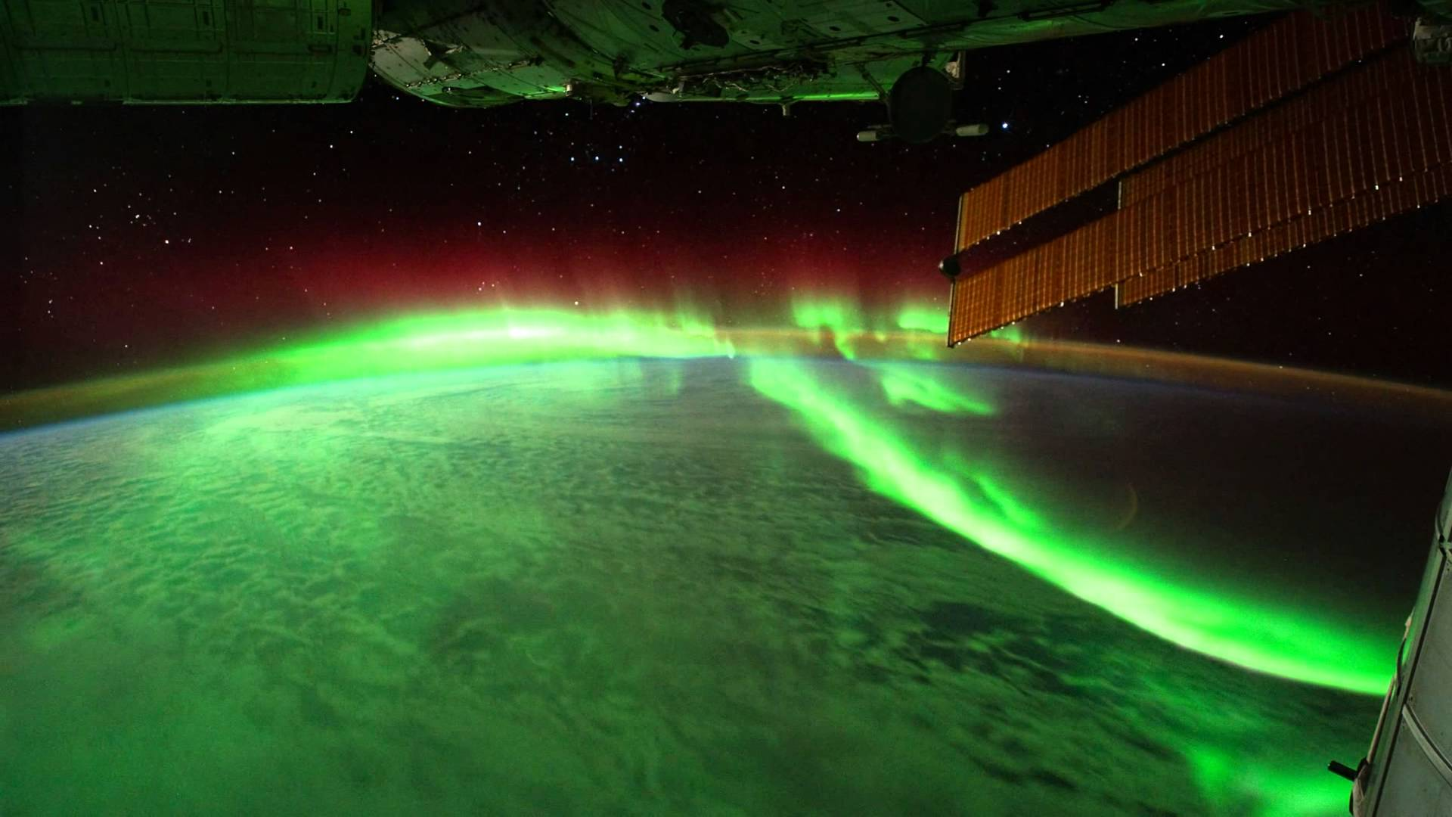
Mission Design

Slide 2
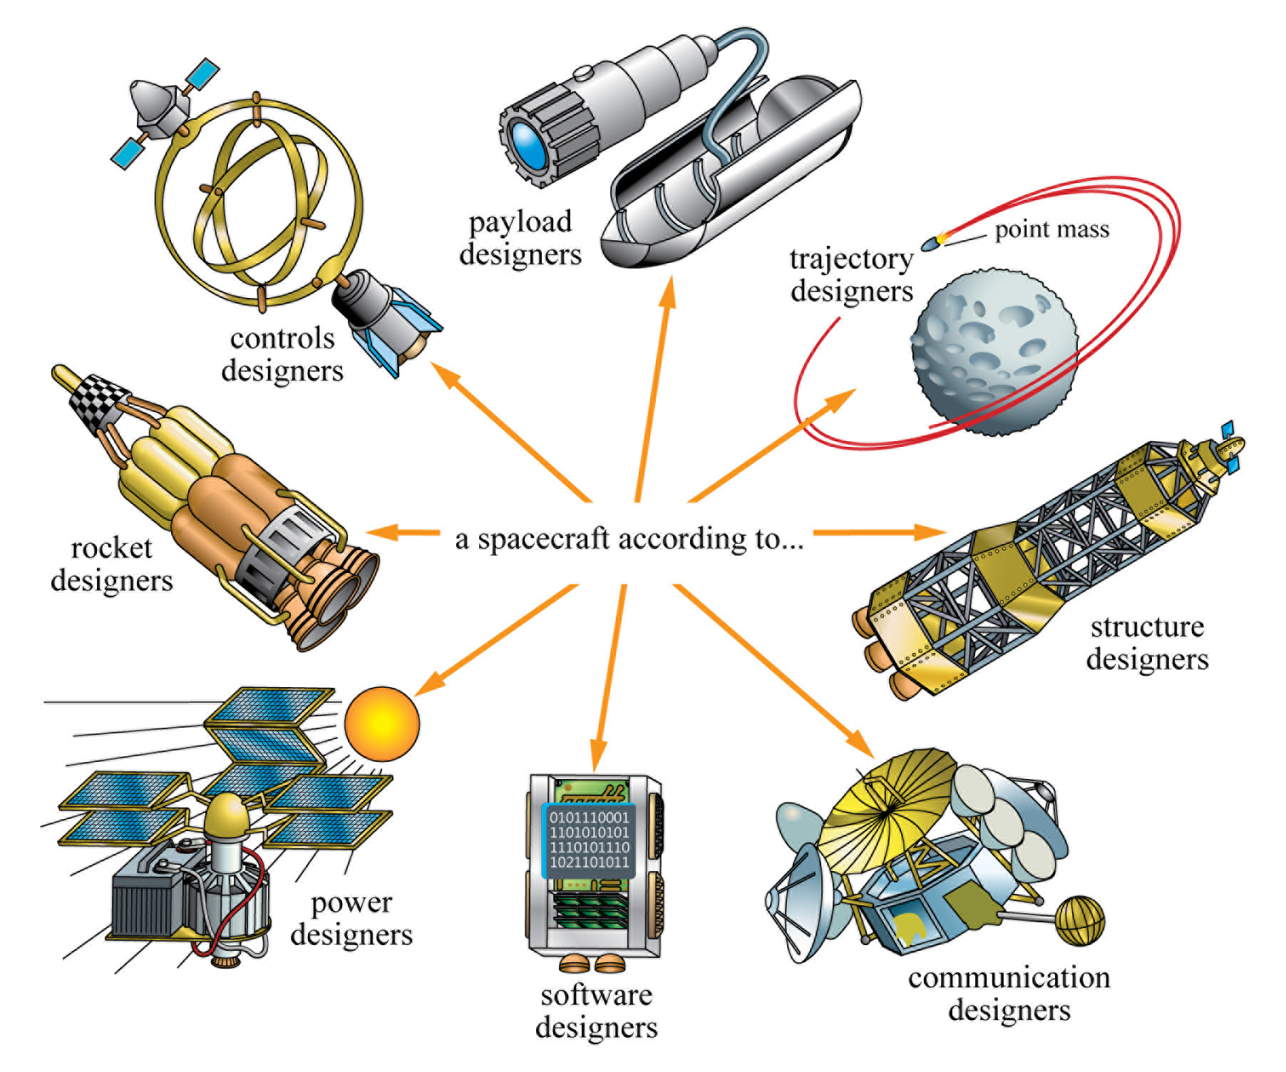

Slide 3
Requirements Vs. Constraints
Requirement
features/capabilities/products/deliverables that expected to be delivered from the project as interim or end results
Requirements focus on the capability of the deliverable rather than the project itself
Constraint
factors that need to be taken into accounts when planning the project. Constraints are mostly restrictions imposed on the project. In the PMBOK® Guide, constraints include a total of 6 competing project constraints:
Scope – what are required/expected of the project?
Time – when will the project need to be finished?
Cost – how much money is provided?
Quality – what is the expectation of the outcome? high or just okay?
Resources – who are the working team members? what equipment/materials are provided?
Risk – what can go wrong with the project and how to deal with them?

Slide 4
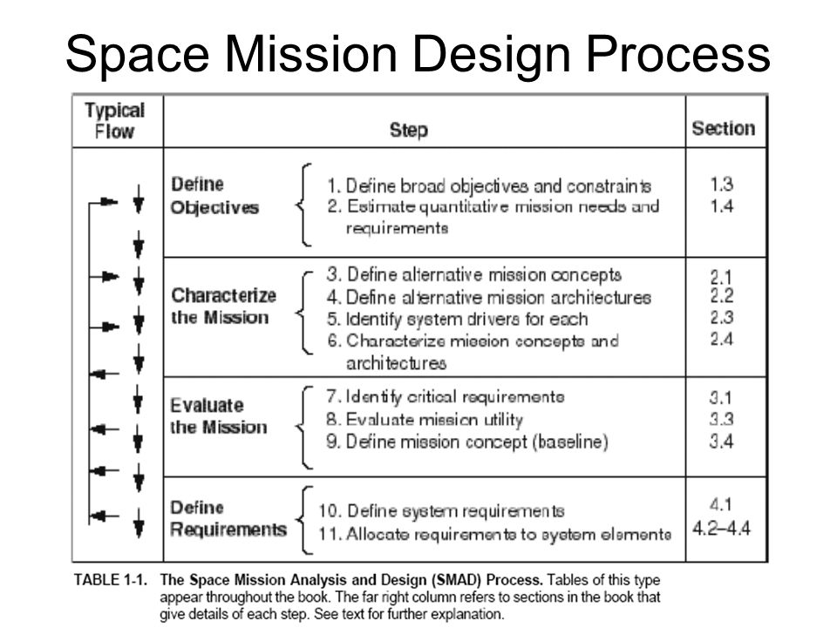

Slide 5
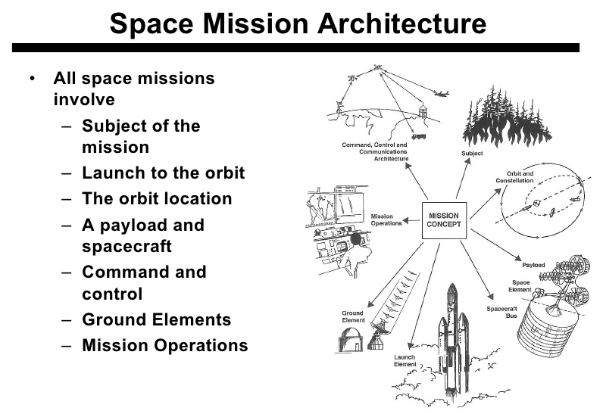
Fig 1-3 Space Mission Architecture

Slide 6
Common System Drivers
Driver | What Limits Driver | What Driver Limits
Size | Shroud or bay size, available weight, aerodynamic drag | Payload size (frequently antenna diameter or aperture)
On-orbit Weight | Altitude, inclination, launch vehicle | Payload weight, survivability; largely determines design and manufacturing cost
Power | Size, weight (control is secondary problem) | Payload & bus design, system sensitivity, on-orbit life
Data rate | Storage, processing, antenna sizes, limits of existing systems | Information sent to user; can push demand for onboard processing
Communications | Coverage, availability of ground stations or relay satellites | Coverage, timeliness, ability to command
Pointing | Cost, mass | Resolution, geolocation, overall system accuracy
Number of Spacecraft | Cost | Coverage frequency, and overlap
Altitude | Launch vehicle, performance demands, weight | Performance, survivability, coverage (instantaneous and rate), communications
Coverage (geometry and timing) | Orbit, scheduling, payload field of view & observation time | Data frequency and continuity, maneuver requirements
Scheduling | Timeline & operations, decision making, communications | Coverage, responsiveness, mission utility
Operations | Cost, crew size, communications | Frequently principal cost driver, principal error source, pushes demand for autonomy (can also save “lost” missions)
Table 2-8 Common System Drivers

Slide 7
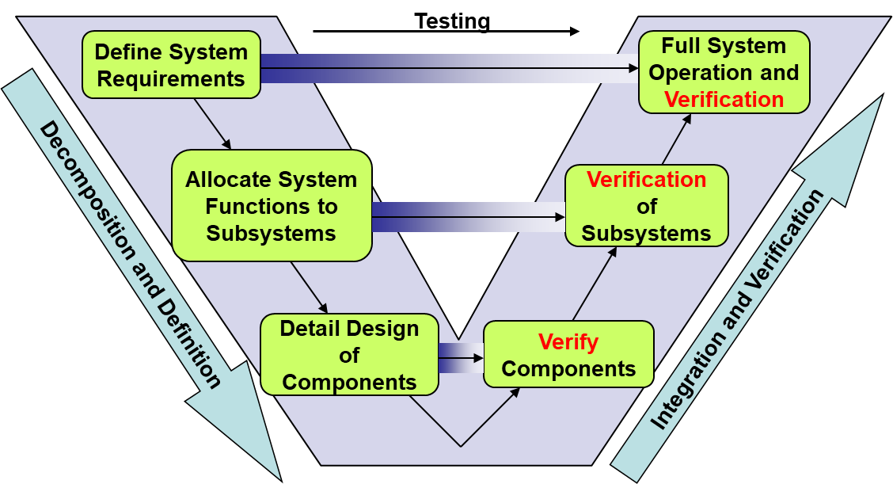
Systems Engineering “V” model
When defining requirements, you are on the top left of the V, but you need to keep in mind the whole V process in order to write a good requirement.
Notes:
Forsberg and Mooz developed
Decomposition on the left down to an architecture, verification and testing up the right side to meet the original customer needs
At all levels the original needs and requirements are verified

Slide 8
Systems Engineering “V” model
verification at each level
verify complete system at the end
can’t verify complete system until the system is complete
need to verify components/subsystems along the way
allocation/closure
note what’s missing: build the system

Slide 9
Allocation and Closure of Requirements
Allocation – assigns the function and its associated performance requirement to a lower level design element
Closure – satisfying lower-level requirements ensures system performance at the next higher level, and that we can trace all requirements back to satisfying mission needs

Slide 10
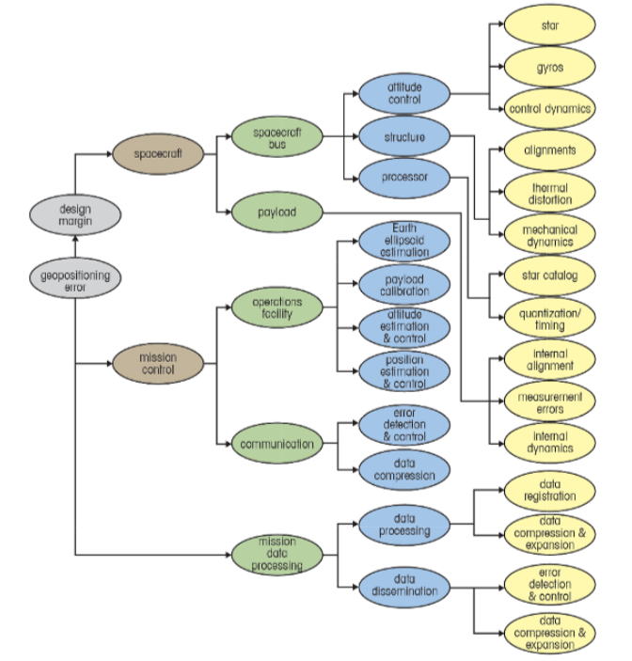
Allocation and Closure of Requirements
requirement allocation (big-to-little/left-to-right) and closure (little-to-big)
Adapted from Fig 4-4 from SMAD v3

Slide 11
Requirements
Requirements will usually be written as sentences or paragraphs:
Attitude control system will maintain bus pointing within 1 degree.
Star sensors will provide accurate bus orientation knowledge with a maximum expected error of 0.2 degree.

Slide 12
Properties of Good Requirements
Unique: no two rqmts overlap or duplicate each other
Unambiguous: no misunderstanding of exactly what is required
Testable: practical way of determining whether delivered system actually meets rqmt
Traceable: every high-level rqmt is broken down into one or more low-level testable requirements and every low-level rqmt supports a documented high-level rqmt
Consistent: doesn’t conflict with other rqmts
Specific: focuses on one thing
Essential: creates a deficiency if deleted
Complete: not missing any conditions or constraints that would distinguish an acceptable system from an unacceptable system

Slide 13
What to Avoid in Writing Good Rqmts
Multiple Rqmts
And
Or
Conditional Clauses
If
Once
When
Unless
Except
Although
Always
Possibilities
Should
Might
Ought
Could
Perhaps
Probably

Slide 14
What to Avoid in Writing Good Rqmts (cont.)
Subjective Phrases
User-friendly
Easy
Simple
Rapid
Efficient
Several
State-of-the-Art
Improve
Maximize
Minimize
Optimize
Adequate
Subjective Phrases (cont.)
Flexible
Approximately
Modern
Versatile
As possible
Facilities
Support
High performance
Large
Intuitive
Robust
Sufficient

Slide 15
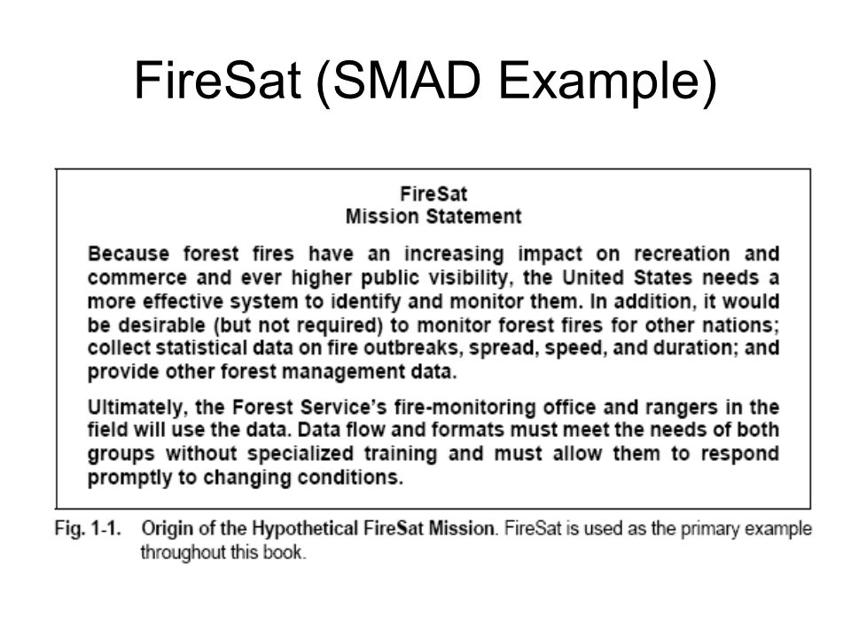

Slide 16
FireSAT Requirements & Constraints
Functional Rqmts | Operational Rqmts | Constraints
Performance 30 m resolution 500 m location accuracy Coverage Daily for USA Responsiveness - Send registered data within 30 min of detecting fire to up to 50 users Secondary Mission 4 temperature levels for pest management | Duration - At leat 5 yrs Availability 98% excluding weather 3-day maximum outage Timeliness Survivability - Natural environment only Data Distribution - Up to 500 fire-monitoring office & 2000 rangers worldwide with a max of 100 simultaneous users Data Content, Form, & Format Location and extent of fire on any of 12 map bases Average temperature for each 30 square meter grid Data Storage | Cost - <$20 million/yr plus R&D costs Schedule IOC in 5 yrs FOC in 6 yrs Regulations - NASA mission (federal regs and procurement constraints apply) Political Limits - Responsive to public demand for actions Economic Return Environment Interfaces - Communication relay and interoperable through NOAA ground stations Development Constraints Launch on Shuttle or expendable No unique operations people at data distribution nodes Spacecraft Disposal
Adapted from Designing Space Mission and Systems,
Teaching Science and Technology, Inc.

Slide 17
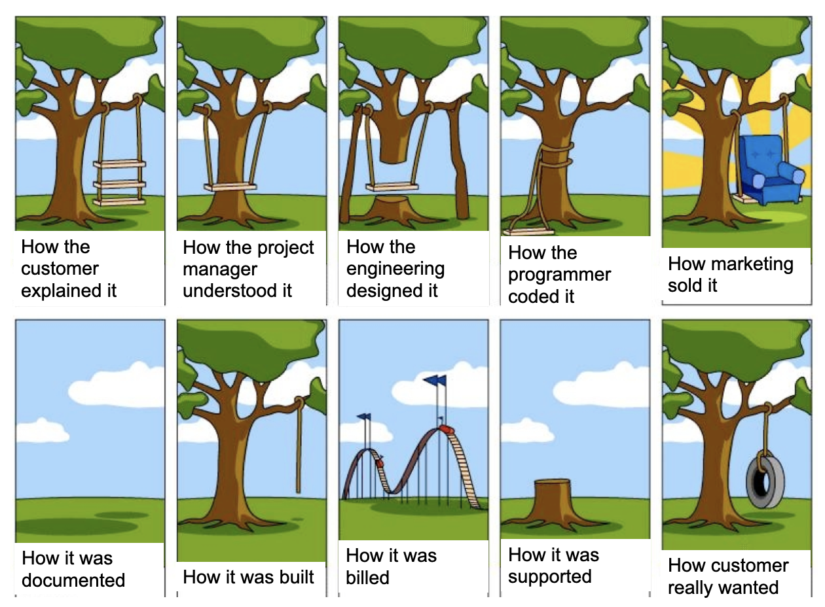

Slide 18
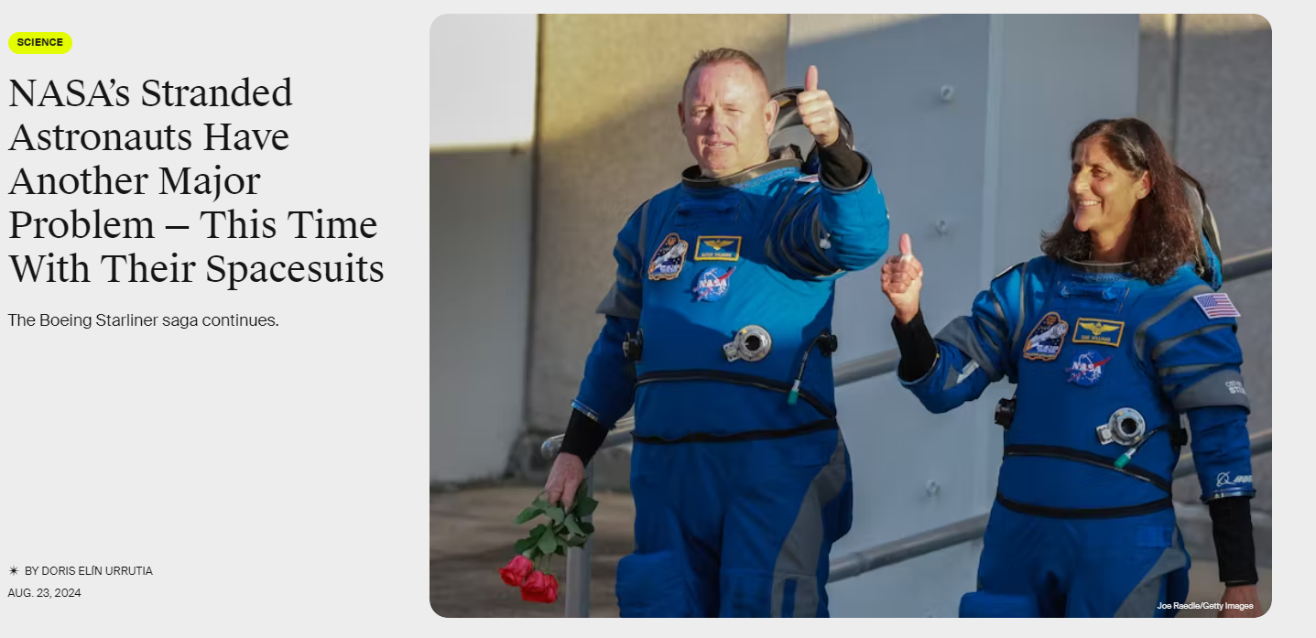
NASA Example
3.2 safety and mission assurance
3.2.5 emergency equipment
3.2.5.2 breathing mask (page 39)

Slide 19
By next Lesson
install by next lesson:
winget install git.git
winget install tortoisegit

